Slide 1
APA Citation Style
ELS 015 Spring 2011

Slide 2
The Original: Annie Ferguson
Likes: 1 Comments: 0

Slide 3
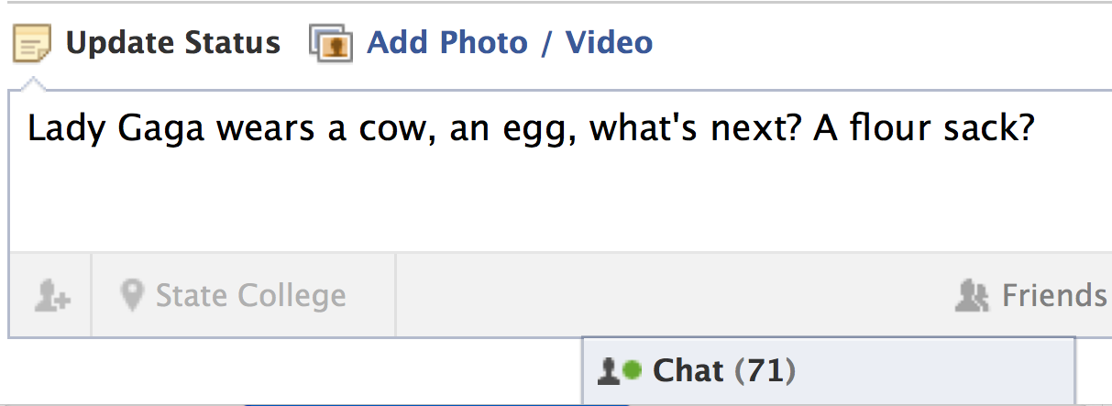
The Copy: Beatrice Thornberry
Likes: 27 Comments: 8
Bobby Bryant: Wow! You’re so funny!
Erica Smith: Where do you come up with this stuff? Hilarious!!!!
Load 6 more comments

Slide 4
Why use a citation style?
Make sure we give the rightful credit to the original source and owner
Reader’s know your are getting information from a valid source
Have the information and research organized

Slide 5
In-text citation options
If you give the author’s name in the sentence, place the date immediately after the author’s name.
Sheli Delost and Sarah Lashley (Year) summarize the controversy: ......(p. xxx)
Writer Joe Kissell (Year), a newcomer to the situation, states: “……” (Page)
If the information can be located on a single page, you should give the page number. This should be placed at the end of the sentence

Slide 6
In-text citation options
You can also name the author in parentheses.
Dr. Robert Shannon, ……, advocates that a Cochlear Implant is ultimately beneficial…… (Alda, Year, Page)
Conine, a commenter in an online deaf forum on Cochlear Implants, says, “……” (Berke, Year, Page)

Slide 7
In-text citation options
No author? Use the title, or a shortened version of the title if it’s long.
“the (Deaf community’s) perception is that there’s nothing wrong. There’s nothing that needs to be fixed……” (“The Cochlear Implant Controversy,” Year, Para.X)

Slide 8
Integrating quotes
Avoid “hit and run” quoting:
Susan Bordo writes about women and dieting. “Fiji is another example. In 1998, three years after programs from the U.S. and Britain began broadcasting there, 62% of girls survey reported dieting.” Another point Bordo makes is that…

Slide 9
Integrating Quotes
Using an introductory or explanatory phrase, separated from the quotation with a comma.
Writer Joe Kissell, a new comer to the situation, states, “Conventional wisdom holds that someone with a cochlear implant is still deaf, and many people……” (Kissell, Year, Page). An outsider, Kissell, after reseaching the different sides of the controversy, agrees that a Cohlear Implant can offer the opportunity to be bilingual and bicultural.

Slide 10
Options for explaining quotes
Basically, X is saying…
In other words, X believes…
X’s point here is…
The essence of X’s argument is….
By giving these statistics, X shows…
Or:
This quote demonstrates…
This line nicely illustrates my argument that…

Slide 11
Reference List Rules
Author:
Publication date:
Title:
Location:

Slide 12
Reference List: Author/ Authors
Single Author
Last name first, followed by author initials.
Berndt, T. J. (2002). Friendship quality and social development. Current Directions in Psychological Science, 11, 7-10.
Two Authors
List by their last names and initials. Use the ampersand instead of "and."
Wegener, D. T., & Petty, R. E. (1994). Mood management across affective states: The hedonic contingency hypothesis. Journal of Personality & Social Psychology, 66, 1034-1048.

Slide 13
Chapters from a book
Example:
The Courtship of Mr Lyon. (1979). In Angela Carter The Bloody Chambers (pp. 76-89). New York: Penguin Group.

Slide 14
Online & Print Newspaper/ Periodicals
Online periodicals:
Parker-Pope, T. (2008, May 6). Psychiatry handbook linked to drug industry. The New York Times. Retrieved from http://www.nytimes.com
Print:
Schultz, S. (2005, December 28). Calls made to strengthen state energy policies. The Country Today, pp. 1A, 2A.

Slide 15
Online and Print Journal Articles
Online Scholarly Journal Articles:
Bernstein, M. (2002). 10 tips on writing the living Web. A list apart: For people who make websites, 149. Retrieved from http://www.alistapart.com/articles/writeliving
Print Journal Articles:
Harlow, H. F. (1983). Fundamentals for preparing psychology journal articles. Journal of Comparative and Physiological Psychology, 55, 893-896.

Slide 16
Clips from YouTube
:

Slide 18
APA Activity
With the given materials create an APA citation.
Write each piece of information on the notecards and place them on the board.
Use the APA Reference Sheet if you don’t remember the correct order.

Slide 19
Where can you learn more?
The PSU library website
The Purdue OWL
Online citation creators:
Sonofcitationmachine.net
Refworks.com
Easybib.com

Slide 20
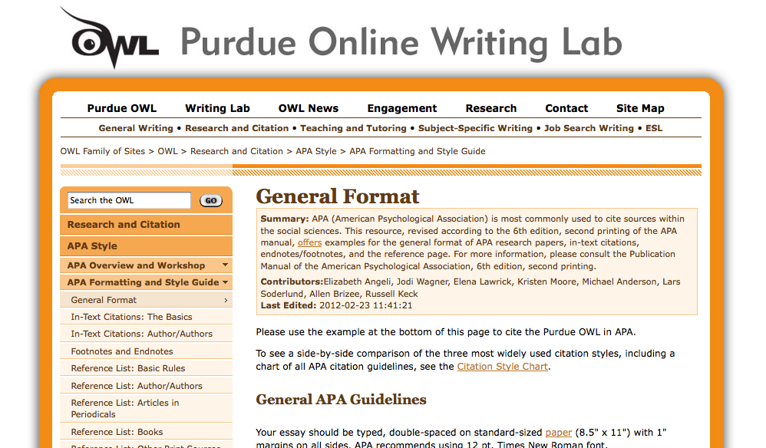
http://owl.english.purdue.edu/owl/resource/560/01/

Slide 21
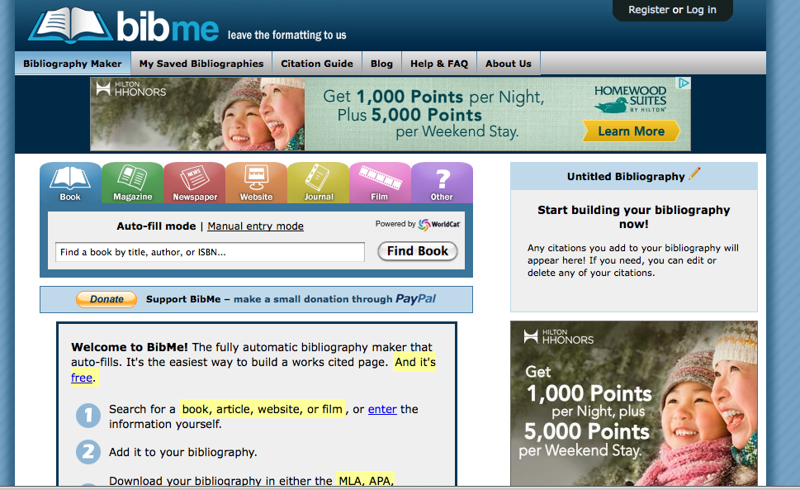
http://www.bibme.org/

