Slide 1
IECP Reading Level 2 Classroom
Christine, Maggie, Ellen and Qin
4/16/2013

Slide 2
Introduction
Classroom Setting:
IECP Level 2 Reading
Intermediate Level
10 students
Course Objectives:
reading comprehension
vocabulary development
Lesson Process:
Warm up---“Words in discussion” activity
Check answers to homework---Discuss problems
Introduce chapter 5--- “Words in Context”

Slide 3
Research Question
How the teacher manipulates classroom interaction differently based on varied pedagogical goals?

Slide 4
Data Collection
Entire 50 minutes of class was video recorded
The two activities “Words in discussion” and “Introduction of vocabulary” were transcribed for data analysis.

Slide 5
Data Analysis
Analyzed through four scopes:
Walsh’s (2011) the IRF exchange structure
Wertsch’s (1985) scaffolding function of teachers’ questions
Mercer’s (2000) types of talk
Walsh’s (2011) SETT (self-evaluation of teacher talk framework)

Slide 6
IRF exchange structure
Initiation – Response – Feedback
Manage the flow of classroom interaction
Pattern will be broken by students’ interruption or teacher overlook students’ contribution
Time pressure may affect the length of each IRF turns

Slide 11
Functions of teacher’s questions
Activity 1 “Words in discussion” : Mostly used questions with scaffolding functions
Activity 2 ““introduction of vocabulary”: Mostly used display question
→ strongly influenced students’ participation

Slide 12
Questions with scaffolding functions -Activity 1
Recruitment (R) to draw students’ attention to the task (lines 55-58)
(R)ensuring student’s participation (lines 82-84)

Slide 13
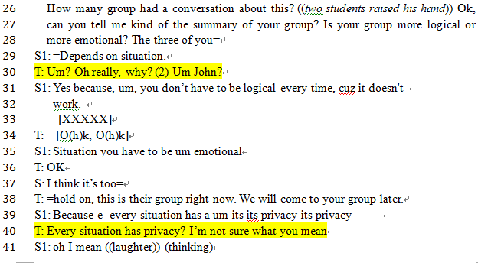
Questions with scaffolding functions -Activity 1
Direction Maintenance-Clarification Request (DM-CR) to ask for clarification and elaboration from the student (lines 30, 40, 66).

Slide 14
Questions with scaffolding functions -Activity 1
Reduction in degrees of freedom (RDF) is used when students have trouble in providing correct answers and by changing vocabulary (lines 69-77).

Slide 15
Display questions –Activity 2
The teacher mostly used the two display questions:
Asking students the part of speech of a vocabulary, such as in line 162, 176, 194, 205, etc.

Slide 16
Display questions –Activity 2
Asking students for the right answer from a list of choices in line 166, 181, 214

Slide 17
Functions of teacher’s questions
Activity 1:
Used questions with scaffolding functions →
Assisted students’ comprehension and maximized students’ participation
Activity 2:
With constant use of display questions→
The teacher-student interaction were almost controlled by the teacher and the response from the students were close to recitation than the classroom dialogue

Slide 18
Types of talk
Disputational talk
Cumulative talk:
positively and uncritically
Joint, additive contribution
Construct common knowledge by accumulation
Repetition, confirmation & elaboration
Exploratory talk:
Engage critically but constructively
Reasons and explanations are explicit
Challenge ideas, then give reasoning
All parties actively participate
Representational speech

Slide 19
Cumulative Talk
Data Set 1: Words in Discussion

Slide 20
Built on each other’s talk, help classmate to express the meaning, complete each other’s sentence, positively construct the conversation through repetition, confirmation and elaboration.
Pedagogical goal: generate oral communication using newly learned words
Pedagogical goal:

Slide 21
Exploratory Talk
A sign, a beginning of exploratory talk,
but was killed very soon.

Slide 22
Data set 2: Introduction of Vocabulary
Teacher’s monologue (line 149-155, 158-162…)
Display questions and fixed answers
Avoidance of students’ response
Pedagogical goal: learn 10 new words in a limited time

Slide 23
SETT/Modes-Activity 1
Fingerprint 1:
Managerial Mode------Material/Classroom Context Mode------Managerial Mode
(data)

Slide 24
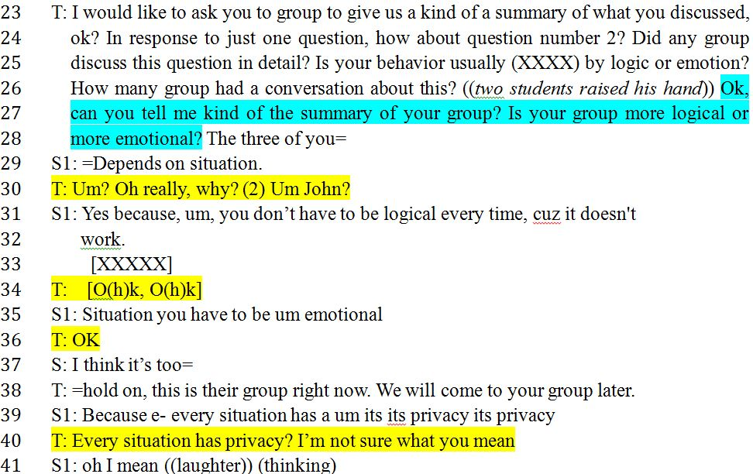
SETT/Modes-Activity 1
Material/Classroom Context Mode:
Based on the type of activity & teacher’s goal

Slide 25
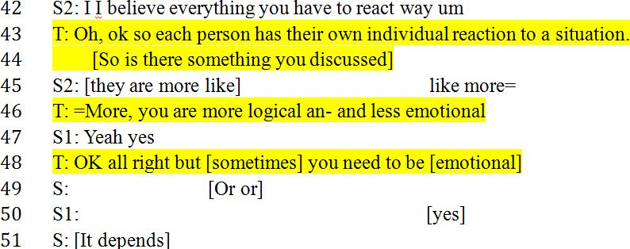
SETT/Modes-Activity 1
Material/Classroom Context Mode:
Based on the type of activity & teacher’s goal (cont’d)

Slide 26
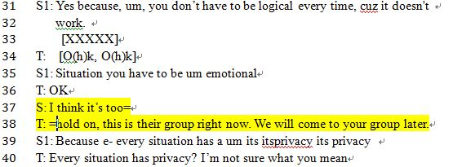
SETT/Modes-Activity 1
Fingerprint1.1:
Within material/classroom context mode:
Managerial Mode appears (if the student brakes the rule)

Slide 27
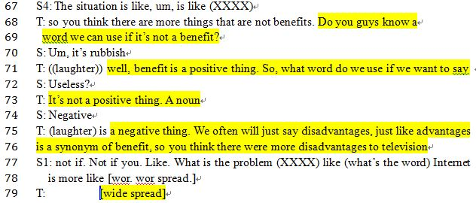
SETT/Modes-Activity 1
Fingerprint1.2:
Within material/classroom context mode
Skills and System Mode appears (based on the instructor’s immediate pedagogical goal)

Slide 28
SETT/Modes-Activity 2
Fingerprint 1:
Managerial Mode------Skills and system Mode------Managerial Mode

Slide 29
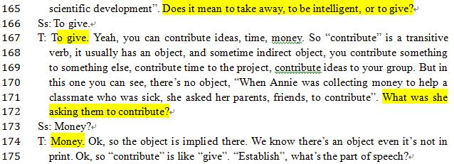
SETT/Modes-Activity 2
Skills and System Mode prevails
extended teacher turns/display questions/correct feedback expected

Slide 30
SETT/Modes-Activity 2
Fingerprint 1.1
Classroom Context Mode occasionally appears
(when the students initiates the turn)

Slide 31
Conclusion
Students’ participation
Teacher’s pedagogical goals
Teacher’s language use

Slide 32
Implications & Suggestions
Implications:
Equal participation
Explicit direction
Suggestions:
Extended wait time
More interactional space

